Slide 1
Bayesian integrated population modeling using JAGS Multistate capture-recapture models
Notes:
Will show two approaches

Slide 2
Multistate capture histories
State = individual, time-specific categorical covariate
Examples of states:
Geographical locations
Breeding status
Disease status
ID | 1992 | 1993 | 1994 | 1995 | 1996 | 1997 | 1998 | 1999
1 | 0 | 1 | 2 | 2 | 0 | 2 | 0 | 0
2 | 1 | 1 | 1 | 0 | 0 | 0 | 0 | 0
3 | 0 | 2 | 0 | 0 | 0 | 0 | 0 | 0
4 | 0 | 0 | 2 | 1 | 0 | 2 | 0 | 0
5 | 0 | 0 | 0 | 1 | 1 | 2 | 1 | 1
6 | 0 | 0 | 0 | 2 | 2 | 1 | 2 | 0

Slide 3
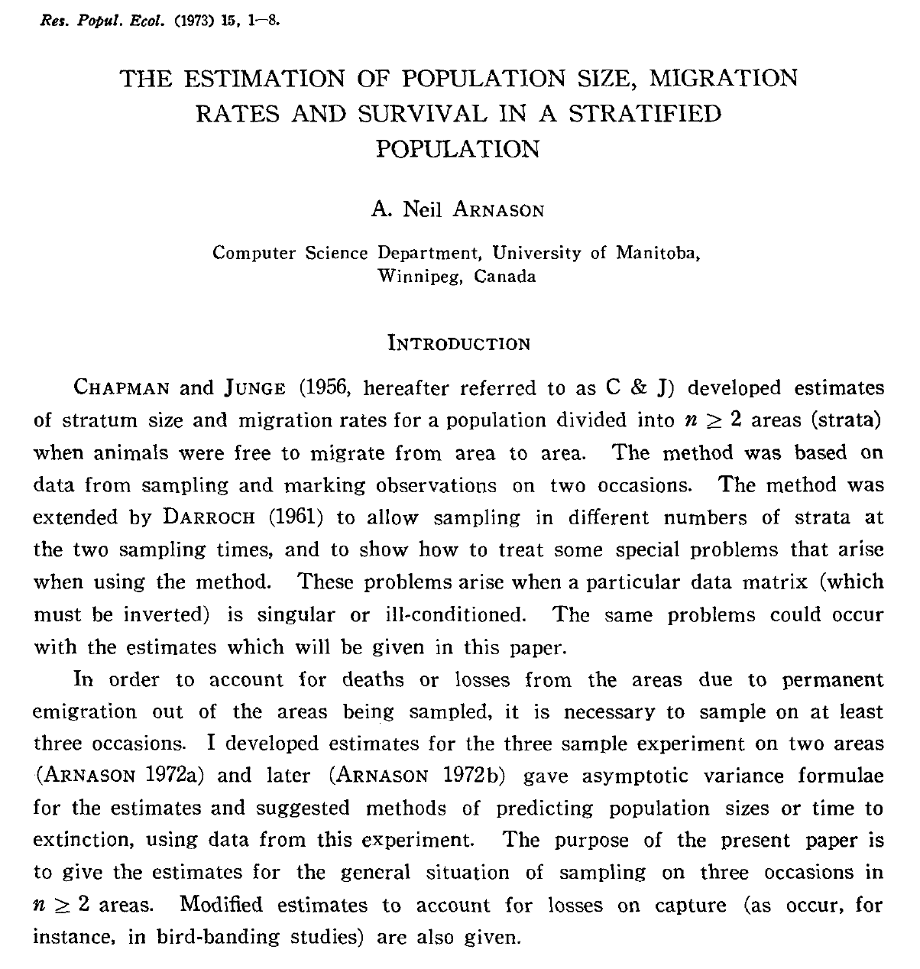
A bit of history

Slide 4
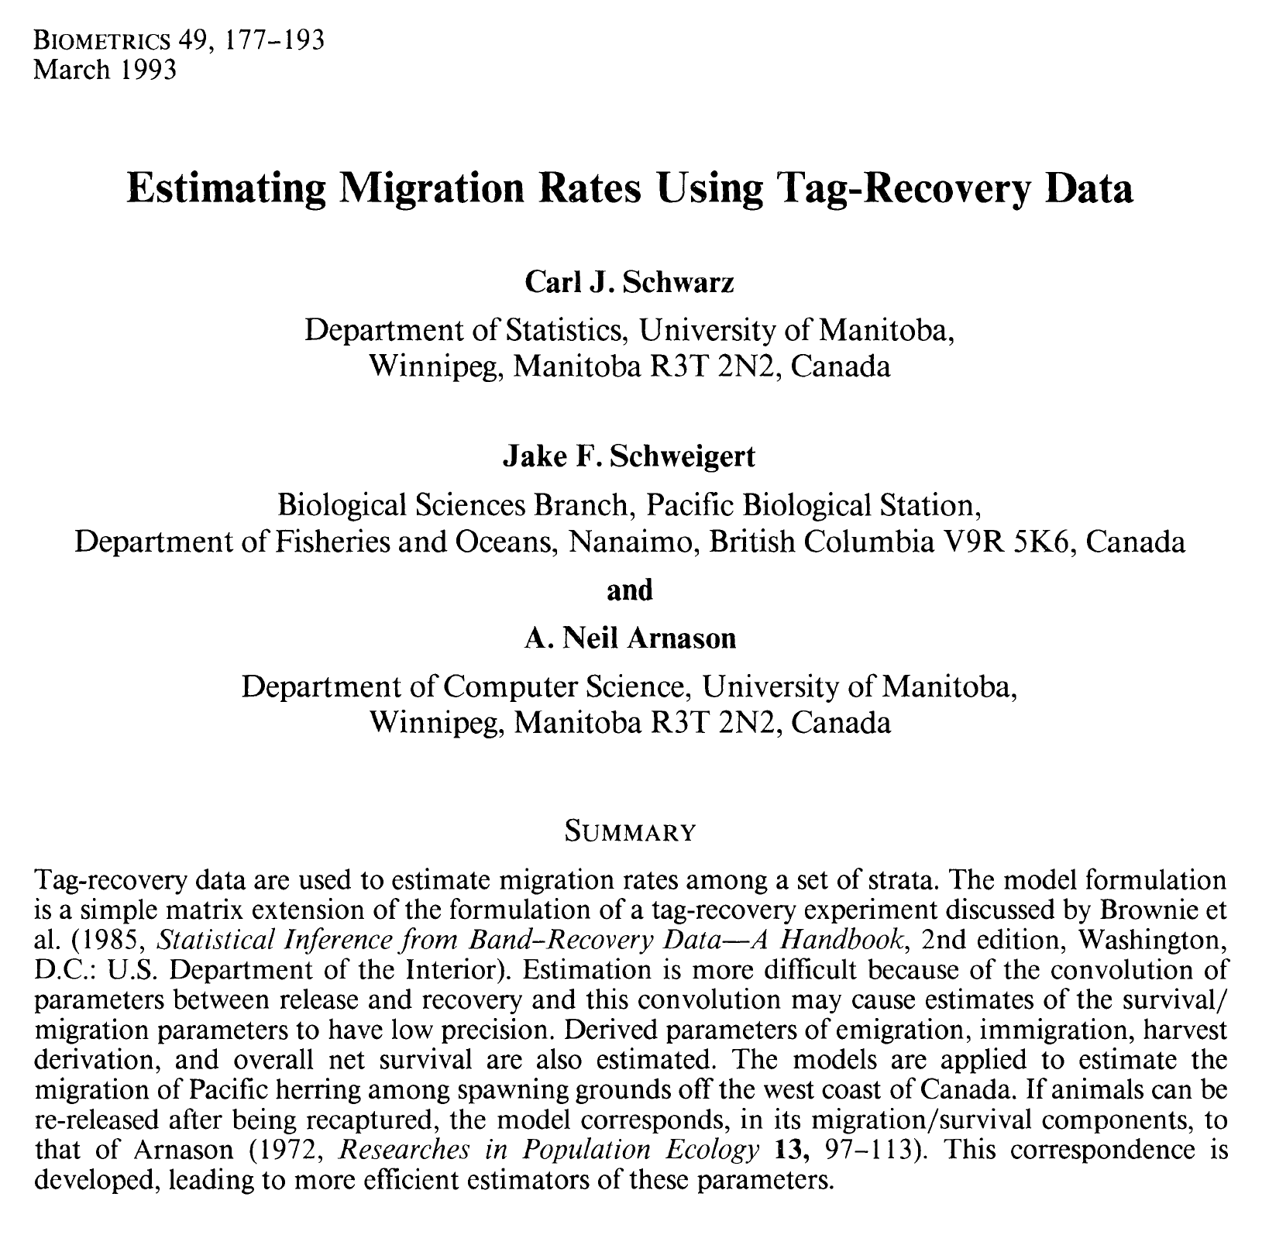
A bit of history

Slide 5
Arnason-Schwarz model
A generalisation of the CJS model to multiple sites

Slide 6

Arnason-Schwarz model
A generalisation of the CJS model to multiple sites

Slide 7


Slide 8
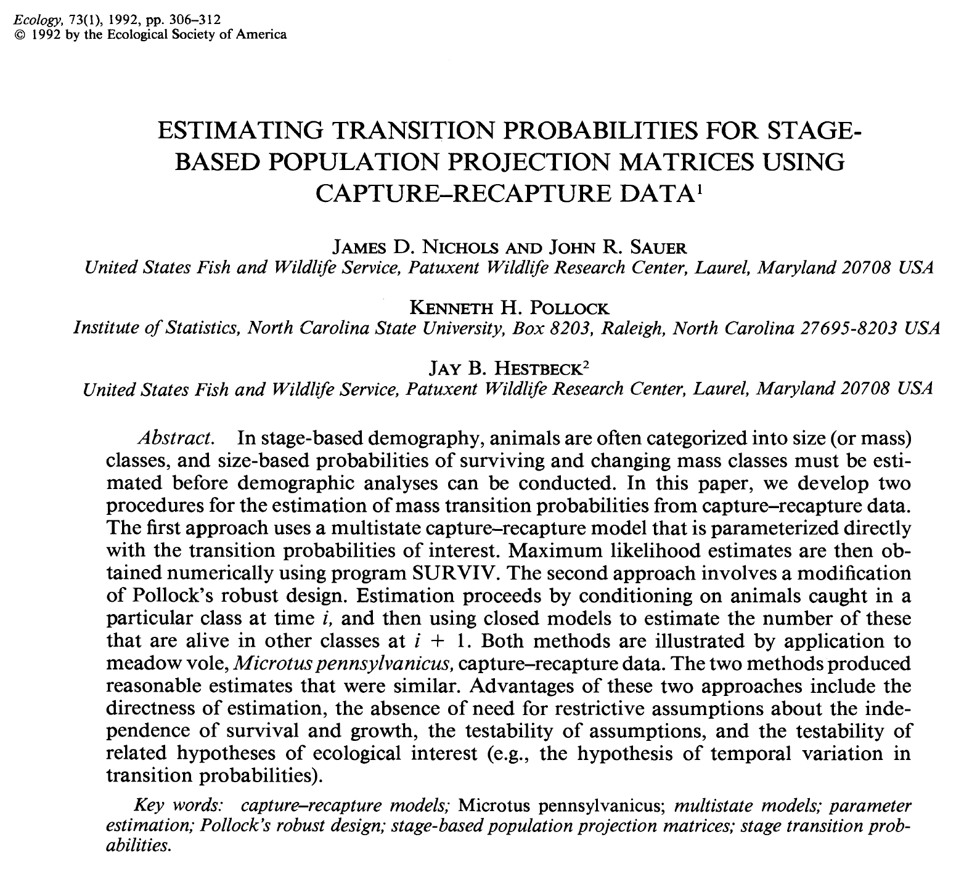
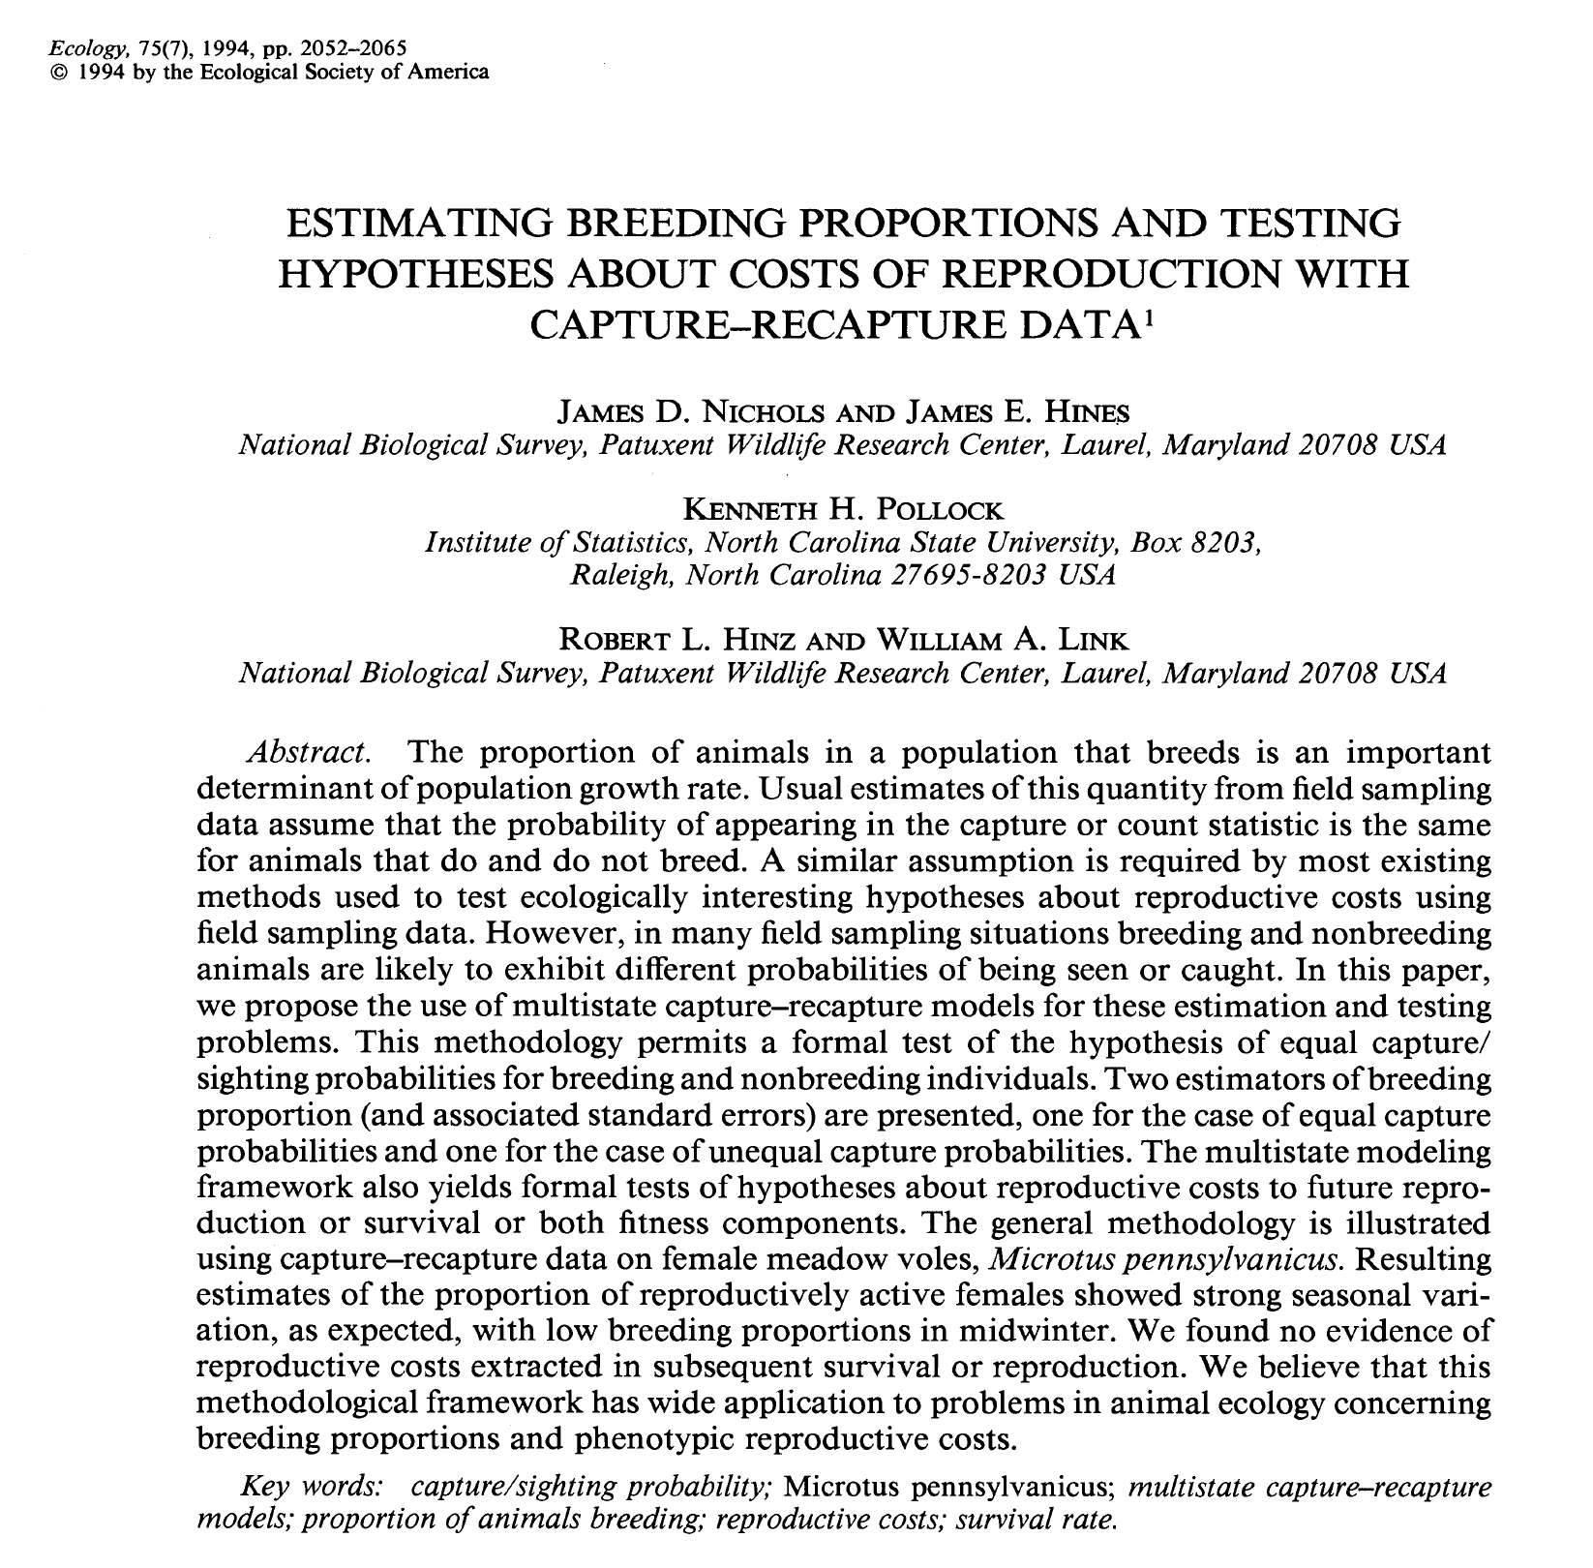
Sites may be states !

Slide 9
Conditional nature of the 2 processes
State process
Site A
Site B
Dead
Stochastic process
Deterministic process
Notes:
9
Note that at the occasion of release, there is no recapture possible and the state „alive“ is sure without uncertainty

Slide 10
Conditional nature of the 2 processes
State process
Site A
Site B
Dead
Seen at A
Seen at B
Not seen
Observation process
Stochastic process
Deterministic process
Notes:
10
Note that at the occasion of release, there is no recapture possible and the state „alive“ is sure without uncertainty

Slide 11
dead
site B
site A
State process
States at time t+1
site A
site B
dead
States at time t
Φ_{xy,t} is probability to be in state y at time t+1, given presence in state x at time t
Notes:
State dead needs to be included, because the transition matrices need to be row stochastic (sum of probabilities in a row is 1)

Slide 12
dead
site B
site A
State process
States at time t+1
site A
site B
dead
States at time t
Observation process
Observations at time t
Not seen
Seen at B
Seen at A
site A
site B
dead
States at time t
Calvert et al. 2009; Servanty et al. 2010
Notes:
State dead needs to be included, because the transition matrices need to be row stochastic (sum of probabilities in a row is 1)

Slide 13
State process
Site A
Site B
Dead
Notes:
13
Note that at the occasion of release, there is no recapture possible and the state „alive“ is sure without uncertainty

Slide 14
State process
dead
site B
site A
States at time t+1
Site A
Site B
Dead
site A
site B
dead
States at time t
Notes:
14
Note that at the occasion of release, there is no recapture possible and the state „alive“ is sure without uncertainty

Slide 15
State process
dead
site B
site A
States at time t+1
Site A
Site B
Dead
site A
site B
dead
States at time t
z_{i,t+1} is state of individual i at time t+1; either alive in site A, in site B or dead.
Notes:
15
Note that at the occasion of release, there is no recapture possible and the state „alive“ is sure without uncertainty

Slide 16
State process
dead
site B
site A
States at time t+1
Site A
Site B
Dead
site A
site B
dead
States at time t
BUGS language:
z_{i,t+1} is state of individual i at time t+1; either alive in site A, in site B or dead.
Notes:
16
Note that at the occasion of release, there is no recapture possible and the state „alive“ is sure without uncertainty

Slide 17
State process
dead
site B
site A
States at time t+1
Site A
Site B
Dead
site A
site B
dead
States at time t
BUGS language:
dcat() is categorical distribution = multinomial distribution with a single trial
Takes a vector of probabilities for each category as argument
Notes:
17
Note that at the occasion of release, there is no recapture possible and the state „alive“ is sure without uncertainty

Slide 18
Observation process
Site A
Site B
Dead
Seen at A
Seen at B
Not seen
Notes:
18
Note that at the occasion of release, there is no recapture possible and the state „alive“ is sure without uncertainty

Slide 19
Observation process
Observations at time t
Site A
Site B
Dead
Not seen
Seen at B
Seen at A
site A
site B
dead
States at time t
Seen at A
Seen at B
Not seen
Notes:
19
Note that at the occasion of release, there is no recapture possible and the state „alive“ is sure without uncertainty

Slide 20
Observation process
Observations at time t
Site A
Site B
Dead
Not seen
Seen at B
Seen at A
site A
site B
dead
States at time t
Seen at A
Seen at B
Not seen
y_{i,t} is observation of individual i at time t; either seen in site A, in site B or not seen.
Notes:
20
Note that at the occasion of release, there is no recapture possible and the state „alive“ is sure without uncertainty

Slide 21
Observation process
Observations at time t
Site A
Site B
Dead
Not seen
Seen at B
Seen at A
site A
site B
dead
States at time t
Seen at A
Seen at B
Not seen
BUGS language:
Notes:
21
Note that at the occasion of release, there is no recapture possible and the state „alive“ is sure without uncertainty

Slide 22
Usual re-parameterisation
Φ_{xy,t}: probability to be in state y at time t+1, given presence in state x at time t

Slide 23
Usual re-parameterisation
Φ_{xy,t}: probability to be in state y at time t+1, given presence in state x at time t
φ_{x}: probability to survive from time t to time t+1, given presence in state x at time t
ψ_{xy,t}: probability to move from state x to state y shortly before time t+1, given survival from time t to time t+1

Slide 24
Model implementation in JAGS
# Likelihood
for (i in 1:nind){
# Define latent state at first capture
z[i,f[i]] <- y[i,f[i]]
for (t in (f[i]+1):n.occasions){
# State process: draw S(t) given S(t-1)
z[i,t] ~ dcat(ps[z[i,t-1], i, t-1,])
# Observation process: draw O(t) given S(t)
y[i,t] ~ dcat(po[z[i,t], i, t-1,])
} #t
} #i
# Define state-transition and observation matrices
for (i in 1:nind){
# Define probabilities of state S(t+1) given S(t)
for (t in f[i]:(n.occasions-1)){
ps[1,i,t,1] <- phiA[t] * (1-psiAB[t])
ps[1,i,t,2] <- phiA[t] * psiAB[t]
ps[1,i,t,3] <- 1-phiA[t]
ps[2,i,t,1] <- phiB[t] * psiBA[t]
ps[2,i,t,2] <- phiB[t] * (1-psiBA[t])
ps[2,i,t,3] <- 1-phiB[t]
ps[3,i,t,1] <- 0
ps[3,i,t,2] <- 0
ps[3,i,t,3] <- 1
# Define probabilities of O(t) given S(t)
po[1,i,t,1] <- pA[t]
po[1,i,t,2] <- 0
po[1,i,t,3] <- 1-pA[t]
po[2,i,t,1] <- 0
po[2,i,t,2] <- pB[t]
po[2,i,t,3] <- 1-pB[t]
po[3,i,t,1] <- 0
po[3,i,t,2] <- 0
po[3,i,t,3] <- 1
} #t
} #i
# Priors and constraints
for (t in 1:(n.occasions-1)){
phiA[t] <- mean.phi[1]
phiB[t] <- mean.phi[2]
psiAB[t] <- mean.psi[1]
psiBA[t] <- mean.psi[2]
pA[t] <- mean.p[1]
pB[t] <- mean.p[2]
}
for (u in 1:2){
mean.phi[u] ~ dunif(0, 1) # Priors for mean state-spec. survival
mean.psi[u] ~ dunif(0, 1) # Priors for mean transitions
mean.p[u] ~ dunif(0, 1) # Priors for mean state-spec. recapture
}

Slide 25
Model implementation in JAGS
# Likelihood
for (i in 1:nind){
# Define latent state at first capture
z[i,f[i]] <- y[i,f[i]]
for (t in (f[i]+1):n.occasions){
# State process: draw S(t) given S(t-1)
z[i,t] ~ dcat(ps[z[i,t-1], i, t-1,])
# Observation process: draw O(t) given S(t)
y[i,t] ~ dcat(po[z[i,t], i, t-1,])
} #t
} #i

Slide 26
Model implementation in JAGS
# Likelihood
for (i in 1:nind){
# Define latent state at first capture
z[i,f[i]] <- y[i,f[i]]
for (t in (f[i]+1):n.occasions){
# State process: draw S(t) given S(t-1)
z[i,t] ~ dcat(ps[z[i,t-1], i, t-1,])
# Observation process: draw O(t) given S(t)
y[i,t] ~ dcat(po[z[i,t], i, t-1,])
} #t
} #i

Slide 27
Model implementation in JAGS
# Likelihood
for (i in 1:nind){
# Define latent state at first capture
z[i,f[i]] <- y[i,f[i]]
for (t in (f[i]+1):n.occasions){
# State process: draw S(t) given S(t-1)
z[i,t] ~ dcat(ps[z[i,t-1], i, t-1,])
# Observation process: draw O(t) given S(t)
y[i,t] ~ dcat(po[z[i,t], i, t-1,])
} #t
} #i

Slide 28
Model implementation in JAGS
# Likelihood
for (i in 1:nind){
# Define latent state at first capture
z[i,f[i]] <- y[i,f[i]]
for (t in (f[i]+1):n.occasions){
# State process: draw S(t) given S(t-1)
z[i,t] ~ dcat(ps[z[i,t-1], i, t-1,])
# Observation process: draw O(t) given S(t)
y[i,t] ~ dcat(po[z[i,t], i, t-1,])
} #t
} #i

Slide 29
Model implementation in JAGS
# Likelihood
for (i in 1:nind){
# Define latent state at first capture
z[i,f[i]] <- y[i,f[i]]
for (t in (f[i]+1):n.occasions){
# State process: draw S(t) given S(t-1)
z[i,t] ~ dcat(ps[z[i,t-1], i, t-1,])
# Observation process: draw O(t) given S(t)
y[i,t] ~ dcat(po[z[i,t], i, t-1,])
} #t
} #i

Slide 30
Model implementation in JAGS
# Likelihood
for (i in 1:nind){
# Define latent state at first capture
z[i,f[i]] <- y[i,f[i]]
for (t in (f[i]+1):n.occasions){
# State process: draw S(t) given S(t-1)
z[i,t] ~ dcat(ps[z[i,t-1], i, t-1,])
# Observation process: draw O(t) given S(t)
y[i,t] ~ dcat(po[z[i,t], i, t-1,])
} #t
} #i
Written generally, no changes needed, regardless model fitted

Slide 31
Model implementation in JAGS
# Define state-transition and observation matrices
for (i in 1:nind){
# Define probabilities of state S(t+1) given S(t)
for (t in f[i]:(n.occasions-1)){
ps[1,i,t,1] <- phiA[t] * (1-psiAB[t])
ps[1,i,t,2] <- phiA[t] * psiAB[t]
ps[1,i,t,3] <- 1-phiA[t]
ps[2,i,t,1] <- phiB[t] * psiBA[t]
ps[2,i,t,2] <- phiB[t] * (1-psiBA[t])
ps[2,i,t,3] <- 1-phiB[t]
ps[3,i,t,1] <- 0
ps[3,i,t,2] <- 0
ps[3,i,t,3] <- 1
# Define probabilities of O(t) given S(t)
po[1,i,t,1] <- pA[t]
po[1,i,t,2] <- 0
po[1,i,t,3] <- 1-pA[t]
po[2,i,t,1] <- 0
po[2,i,t,2] <- pB[t]
po[2,i,t,3] <- 1-pB[t]
po[3,i,t,1] <- 0
po[3,i,t,2] <- 0
po[3,i,t,3] <- 1
} #t
} #i
Define the structure of the multistate model

Slide 32
Model implementation in JAGS
# Define state-transition and observation matrices
for (i in 1:nind){
# Define probabilities of state S(t+1) given S(t)
for (t in f[i]:(n.occasions-1)){
ps[1,i,t,1] <- phiA[t] * (1-psiAB[t])
ps[1,i,t,2] <- phiA[t] * psiAB[t]
ps[1,i,t,3] <- 1-phiA[t]
ps[2,i,t,1] <- phiB[t] * psiBA[t]
ps[2,i,t,2] <- phiB[t] * (1-psiBA[t])
ps[2,i,t,3] <- 1-phiB[t]
ps[3,i,t,1] <- 0
ps[3,i,t,2] <- 0
ps[3,i,t,3] <- 1
# Define probabilities of O(t) given S(t)
po[1,i,t,1] <- pA[t]
po[1,i,t,2] <- 0
po[1,i,t,3] <- 1-pA[t]
po[2,i,t,1] <- 0
po[2,i,t,2] <- pB[t]
po[2,i,t,3] <- 1-pB[t]
po[3,i,t,1] <- 0
po[3,i,t,2] <- 0
po[3,i,t,3] <- 1
} #t
} #i
Define the structure of the multistate model

Slide 33
Model implementation in JAGS
# Define state-transition and observation matrices
for (i in 1:nind){
# Define probabilities of state S(t+1) given S(t)
for (t in f[i]:(n.occasions-1)){
ps[1,i,t,1] <- phiA[t] * (1-psiAB[t])
ps[1,i,t,2] <- phiA[t] * psiAB[t]
ps[1,i,t,3] <- 1-phiA[t]
ps[2,i,t,1] <- phiB[t] * psiBA[t]
ps[2,i,t,2] <- phiB[t] * (1-psiBA[t])
ps[2,i,t,3] <- 1-phiB[t]
ps[3,i,t,1] <- 0
ps[3,i,t,2] <- 0
ps[3,i,t,3] <- 1
# Define probabilities of O(t) given S(t)
po[1,i,t,1] <- pA[t]
po[1,i,t,2] <- 0
po[1,i,t,3] <- 1-pA[t]
po[2,i,t,1] <- 0
po[2,i,t,2] <- pB[t]
po[2,i,t,3] <- 1-pB[t]
po[3,i,t,1] <- 0
po[3,i,t,2] <- 0
po[3,i,t,3] <- 1
} #t
} #i
Define the structure of the multistate model

Slide 34
Model implementation in JAGS
# Priors and constraints
for (t in 1:(n.occasions-1)){
phiA[t] <- mean.phi[1]
phiB[t] <- mean.phi[2]
psiAB[t] <- mean.psi[1]
psiBA[t] <- mean.psi[2]
pA[t] <- mean.p[1]
pB[t] <- mean.p[2]
}
for (u in 1:2){
mean.phi[u] ~ dunif(0, 1)
mean.psi[u] ~ dunif(0, 1)
mean.p[u] ~ dunif(0, 1)
}
Define linear contraints on parameters & specify the needed priors

Slide 35
Model implementation in JAGS
# Priors and constraints
for (t in 1:(n.occasions-1)){
phiA[t] <- mean.phi[1]
phiB[t] <- mean.phi[2]
psiAB[t] <- mean.psi[1]
psiBA[t] <- mean.psi[2]
pA[t] <- mean.p[1]
pB[t] <- mean.p[2]
}
for (u in 1:2){
mean.phi[u] ~ dunif(0, 1)
mean.psi[u] ~ dunif(0, 1)
mean.p[u] ~ dunif(0, 1)
}
Define linear contraints on parameters & specify the needed priors

Slide 36
Model implementation in JAGS
# Priors and constraints
for (t in 1:(n.occasions-1)){
phiA[t] <- mean.phi[1]
phiB[t] <- mean.phi[2]
psiAB[t] <- mean.psi[1]
psiBA[t] <- mean.psi[2]
pA[t] <- mean.p[1]
pB[t] <- mean.p[2]
}
for (u in 1:2){
mean.phi[u] ~ dunif(0, 1)
mean.psi[u] ~ dunif(0, 1)
mean.p[u] ~ dunif(0, 1)
}
Define linear contraints on parameters & specify the needed priors

Slide 37
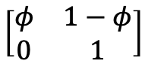
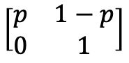
CJS models are multistate models w/ 2 states: alive and dead
# Define state-transition and observation matrices
for (i in 1:nind){
# Define probabilities of state S(t+1) given S(t)
for (t in f[i]:(n.occasions-1)){
ps[1,i,t,1] <- phi[t]
ps[1,i,t,2] <- 1 - phi[t]
ps[2,i,t,1] <- 0
ps[2,i,t,2] <- 1
# Define probabilities of O(t) given S(t)
po[1,i,t,1] <- p[t]
po[1,i,t,2] <- 1 - p[t]
po[2,i,t,1] <- 0
po[2,i,t,2] <- 1
} #t
} #i
$$\left[\begin{matrix}φ & 1−φ \\ 0 & 1\end{matrix}\right]$$
$$\left[\begin{matrix}p & 1−p \\ 0 & 1\end{matrix}\right]$$

Slide 38
CJS models are multistate models w/ 2 states: alive and dead
# Define state-transition and observation matrices
for (i in 1:nind){
# Define probabilities of state S(t+1) given S(t)
for (t in f[i]:(n.occasions-1)){
ps[1,i,t,1] <- phi[t]
ps[1,i,t,2] <- 1 - phi[t]
ps[2,i,t,1] <- 0
ps[2,i,t,2] <- 1
# Define probabilities of O(t) given S(t)
po[1,i,t,1] <- p[t]
po[1,i,t,2] <- 1 - p[t]
po[2,i,t,1] <- 0
po[2,i,t,2] <- 1
} #t
} #i
$$\left[\begin{matrix}φ & 1−φ \\ 0 & 1\end{matrix}\right]$$
$$\left[\begin{matrix}p & 1−p \\ 0 & 1\end{matrix}\right]$$
Some code here: https://github.com/oliviergimenez/multievent_jags_R

Slide 39
Exercise 3

Slide 40
Multistate models are very flexible (Lebreton et al. 2009)
Notes:
40
Sometimes the non-breeders may not be seen. Then we have a model with an unobservable state (non-breeders).
Such a model has identifiability issues, namely that survival of breeders and non-breeders cannot be estimated seperately and that transitions much be Markovian (non-random).
The model is then also identical to a model for temporary emigration which we will see shortly

Slide 41
Multistate models are very flexible: some examples
1. Breeder vs. non-breeders
dead
non-br.
breeding
State-space likelihood
States at time t+1
breeding
non-breeding
dead
States at time t
Observations at time t
not seen
seen, non-br.
seen, br.
breeding
non-breeding
dead
States at time t
Notes:
41
Sometimes the non-breeders may not be seen. Then we have a model with an unobservable state (non-breeders).
Such a model has identifiability issues, namely that survival of breeders and non-breeders cannot be estimated seperately and that transitions much be Markovian (non-random).
The model is then also identical to a model for temporary emigration which we will see shortly

Slide 42
Multistate models are very flexible: some examples
2. Movement among 3 sites
,
States at time t+1
State process
States at time t
Notes:
42

Slide 43
Multistate models are very flexible: some examples
2. Movement among 3 sites
,
States at time t+1
State process
States at time t
Observations at time t
Observation process
States at time t
Notes:
43

Slide 44
Multistate models are very flexible: some examples
2. Movement among 3 sites
,
States at time t+1
State process
States at time t
The parameters ψ_{AB} and ψ_{AC} (as well as ψ_{BA} & ψ_{BC} and ψ_{CA} & ψ_{CB}) must be in the interval [0, 1] and their sum must be ≤ 1.
Notes:
44

Slide 45
Multistate models are very flexible: some examples
2. Movement among 3 sites
,
States at time t+1
State process
States at time t
The parameters ψ_{AB} and ψ_{AC} (as well as ψ_{BA} & ψ_{BC} and ψ_{CA} & ψ_{CB}) must be in the interval [0, 1] and their sum must be ≤ 1.
Two options:
Multinomial logit link function (ch 10 Kéry & Schaub 2012, Guéry et al. 2018)
Dirichlet prior (ch 10 Kéry & Schaub 2012)
Notes:
45

Slide 46
dead
breeder
2y NB
1y NB
juvenile
Multistate models are very flexible: some examples
3. Access to reproduction
States at time t+1
State process
juvenile
1y NB
2y NB
breeder
dead
States at time t
Notes:
46
Key question: in which age start the individuals with reproduction. What is the mean age at first reproduction?
Here is a model where we assume that at age 3 all reproduce. These models need such a constraint (age at which all reproduce). But this is not really restrictive, since it is always possible to include many age classes.
Observation model: here we assume that p are different for the first time and experienced breeders.
Model can only include individuals of known age.

Slide 47
dead
breeder
2y NB
1y NB
juvenile
Multistate models are very flexible: some examples
3. Access to reproduction
States at time t+1
State process
juvenile
1y NB
2y NB
breeder
dead
States at time t
Observations at time t
not seen
seen, breeder
seen, 2y NB
seen, 1y NB
Observation process
juvenile
1y NB
2y NB
breeder
dead
States at time t
Notes:
47
Key question: in which age start the individuals with reproduction. What is the mean age at first reproduction?
Here is a model where we assume that at age 3 all reproduce. These models need such a constraint (age at which all reproduce).
But this is not really restrictive, since it is always possible to include many age classes.
Observation model: here we assume that p are different for the first time and experienced breeders.
Model can only include individuals of known age.

Slide 48
Multistate models are very flexible: some examples
4. Temporary emigration
Notes:
48

Slide 49
Multistate models are very flexible: some examples
4. Temporary emigration
dead
outside
inside
States at time t+1
State process
inside
outside
dead
States at time t
Notes:
49

Slide 50
Multistate models are very flexible: some examples
4. Temporary emigration
dead
outside
inside
States at time t+1
State process
inside
outside
dead
States at time t
Observations at time t
Observation process
Not seen
Seen
inside
outside
dead
States at time t
Notes:
50

Slide 51
Multistate models are very flexible: some examples
5. Immediate trap response
Notes:
51

Slide 52
Multistate models are very flexible: some examples
5. Immediate trap response
dead
a, not s
a, seen
States at time t+1
State process
alive, seen
alive, not seen
dead
States at time t
Notes:
52

Slide 53
Multistate models are very flexible: some examples
5. Immediate trap response
dead
a, not s
a, seen
States at time t+1
State process
alive, seen
alive, not seen
dead
States at time t
Observations at time t
Observation process
Not seen
Seen
alive, seen
alive, not seen
dead
States at time t
Notes:
53

Slide 54
Multistate models are very flexible: some examples
6. Combination of life and dead encounters
Notes:
54

Slide 55
Multistate models are very flexible: some examples
6. Combination of life and dead encounters
States at time t+1
dead
rec. dead
alive
State process
alive
recently dead
dead
States at time t
Notes:
55

Slide 56
Multistate models are very flexible: some examples
6. Combination of life and dead encounters
States at time t+1
dead
rec. dead
alive
State process
alive
recently dead
dead
States at time t
Observations at time t
not seen
recovered
seen
Observation process
alive
rec. dead
dead
States at time t
Notes:
56

Slide 57
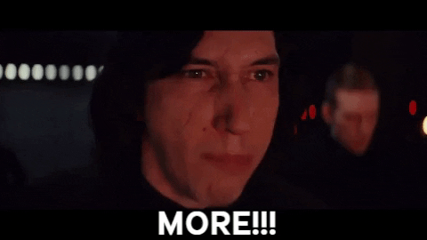
What if you could achieve even more flexibility?
Notes:
57
conjunctivitis

Slide 58
Multievent models
Multievent models extend multistate models with uncertainty in state assignment
Breeding status in female roe deer is ascertained based on fawn detection
Sex status is ascertained based on morphological criteria in Audouin’s gulls
Disease status in house finches is ascertained based on birds’ eyes examination
Notes:
58
conjunctivitis

Slide 59
Multievent models
Multievent models extend multistate models with uncertainty in state assignment
Breeding status in female roe deer is ascertained based on fawn detection
Sex status is ascertained based on morphological criteria in Audouin’s gulls
Disease status in house finches is ascertained based on birds’ eyes examination
We will need to explicitely consider state assignment in a model
Notes:
59
conjunctivitis

Slide 60
Multievent models
Multievent models extend multistate models with uncertainty in state assignment
Breeding status in female roe deer is ascertained based on fawn detection
Sex status is ascertained based on morphological criteria in Audouin’s gulls
Disease status in house finches is ascertained based on birds’ eyes examination
We will need to explicitely consider state assignment in a model
All capture-recapture models can be seen as special cases of multievent models
Seminal paper by Pradel (2005); see also Gimenez et al. (2012) for a review
Dupuis (1995) had a similar idea, for the Arnason-Schwarz model
Notes:
60
conjunctivitis

Slide 61
Conditional nature of the 2 processes
State process
State 1
State 2
Dead
Stochastic process
Deterministic process
Notes:
61
Initial state is uncertain.
Yet, the model is still conditional on first capture (i.e. it is sure that the individual is captured, but the state might have been recorded wrongly).
After first capture, the observation process contains 2 kinds of uncertainty: first the individual may or may not be recaptured, and, given recapture, ist state may or may not be recorded correctly.
Therefore the stochastic process is different (at first capture it is simpler and consists just of the state assignment error).

Slide 62
Conditional nature of the 2 processes
State process
State 1
State 2
Dead
Seen 1
Seen 2
Not seen
Observation process
Stochastic process
Deterministic process
Notes:
62
Initial state is uncertain.
Yet, the model is still conditional on first capture (i.e. it is sure that the individual is captured, but the state might have been recorded wrongly).
After first capture, the observation process contains 2 kinds of uncertainty: first the individual may or may not be recaptured, and, given recapture, ist state may or may not be recorded correctly.
Therefore the stochastic process is different (at first capture it is simpler and consists just of the state assignment error).

Slide 63
Uncertainty in breeding status
3 states
breeding (B)
non-breeding (NB)
Dead (†)
4 observations
Not encountered (0)
Found, ascertained as breeder (1)
Found, ascertained as non-breeder (2)
Found, status unknown (3)
Desprez et al. 2011, 2013; Couet et al. 2019

Slide 64
The model construction
States
Breeding
Non-breeding
Dead
Observations
(0) Not encountered
(1) Found, identified as B
(2) Found, identified as NB
(3) Found, status unknown

Slide 65
The model construction
States
Breeding
Non-breeding
Dead
Observations
(0) Not encountered
(1) Found, identified as B
(2) Found, identified as NB
(3) Found, status unknown

Slide 66
The model construction
States
Breeding
Non-breeding
Dead
Observations
(0) Not encountered
(1) Found, identified as B
(2) Found, identified as NB
(3) Found, status unknown

Slide 67
The model construction
States
Breeding
Non-breeding
Dead
Observations
(0) Not encountered
(1) Found, identified as B
(2) Found, identified as NB
(3) Found, status unknown

Slide 68
The model construction
States
Breeding
Non-breeding
Dead
Observations
(0) Not encountered
(1) Found, identified as B
(2) Found, identified as NB
(3) Found, status unknown
Each live state can generate 3 different events

Slide 69
Initial state probabilities
π_{B} probability that a newly encountered individual is a breeder
B NB †

Slide 70
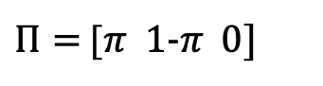
Initial state probabilities
π_{B} probability that a newly encountered individual is a breeder
B NB †
BUGS language:
$Π=$[$π 1\text{−}π 0]$

Slide 71
transition parameters
B NB †
B
NB
†

Slide 72
transition parameters
B NB †
B
NB
†
BUGS language:

Slide 73
transition parameters - 2 steps
SB SNB †
B(t)
NB(t)
†
Step 1: Survival
Intermediate states: SB = ‘surviving breeder’; SNB = ‘surviving non-breeder’
B(t+1) NB(t+1) †
SB
SNB
†
Step 2:
Breeding

Slide 74
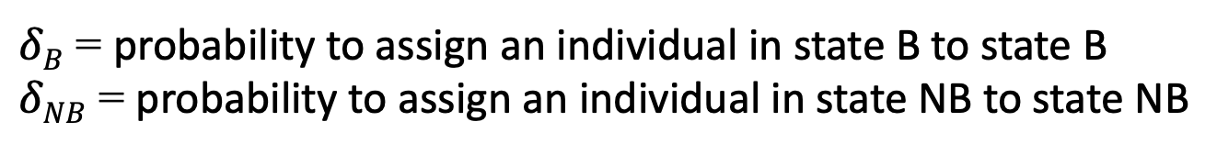
observation parameters
$δB$ = probability to assign an individual in state B to state B
$δNB$ = probability to assign an individual in state NB to state NB
Notes:
Explain parameters:
Pi: prob. to be in state 2 at first encounter
Beta1: prob. to correctly assign an indiv. that is in state 1 to state 1
Beta2: prob. to correctly assign an indiv. that is in state 2 to state 2

Slide 75
observation parameters
1 2 3 4
B
NB
†
B
NB
†
$δB$ = probability to assign an individual in state B to state B
$δNB$ = probability to assign an individual in state NB to state NB
Notes:
Explain parameters:
Pi: prob. to be in state 2 at first encounter
Beta1: prob. to correctly assign an indiv. that is in state 1 to state 1
Beta2: prob. to correctly assign an indiv. that is in state 2 to state 2

Slide 76
observation parameters
1 2 3 4
B
NB
†
B
NB
†
BUGS language:
Notes:
Explain parameters:
Pi: prob. to be in state 2 at first encounter
Beta1: prob. to correctly assign an indiv. that is in state 1 to state 1
Beta2: prob. to correctly assign an indiv. that is in state 2 to state 2

Slide 77
observations parameters – 2 steps
E_{B} E_{NB} NE
B
NB
†
Step 1: Encounter
Intermediate events: NE = ‘not encountered’; E = ‘encountered’
1 2 3 4
E_{B} E_{NB}
NE
Step 2: Breeding assessment

Slide 78
initial events
Step 1 (encounter) is degenerate because animals are all captured.
E_{B} E_{NB} NE
E_{B} E_{NB} NE
B
NB
†
B
NB
†
p = 1
Step 2 (Breeding assessment) is unaffected
1 2 3 4
E_{B} E_{NB}
NE

Slide 79
The generic multievent model
probabilities of observations conditional on current state
y₁
y₂
y₃
observations
z₁
z₂
z₃
states
initial state probabilities
probabilities of transition
Multievent models are hidden Markov models (HMMs)
Notes:
A typical sequence in a capture history would be…. The truth is

Slide 80

HMMs = SSMs with discrete states, and Markovian dynamics of states

Slide 81
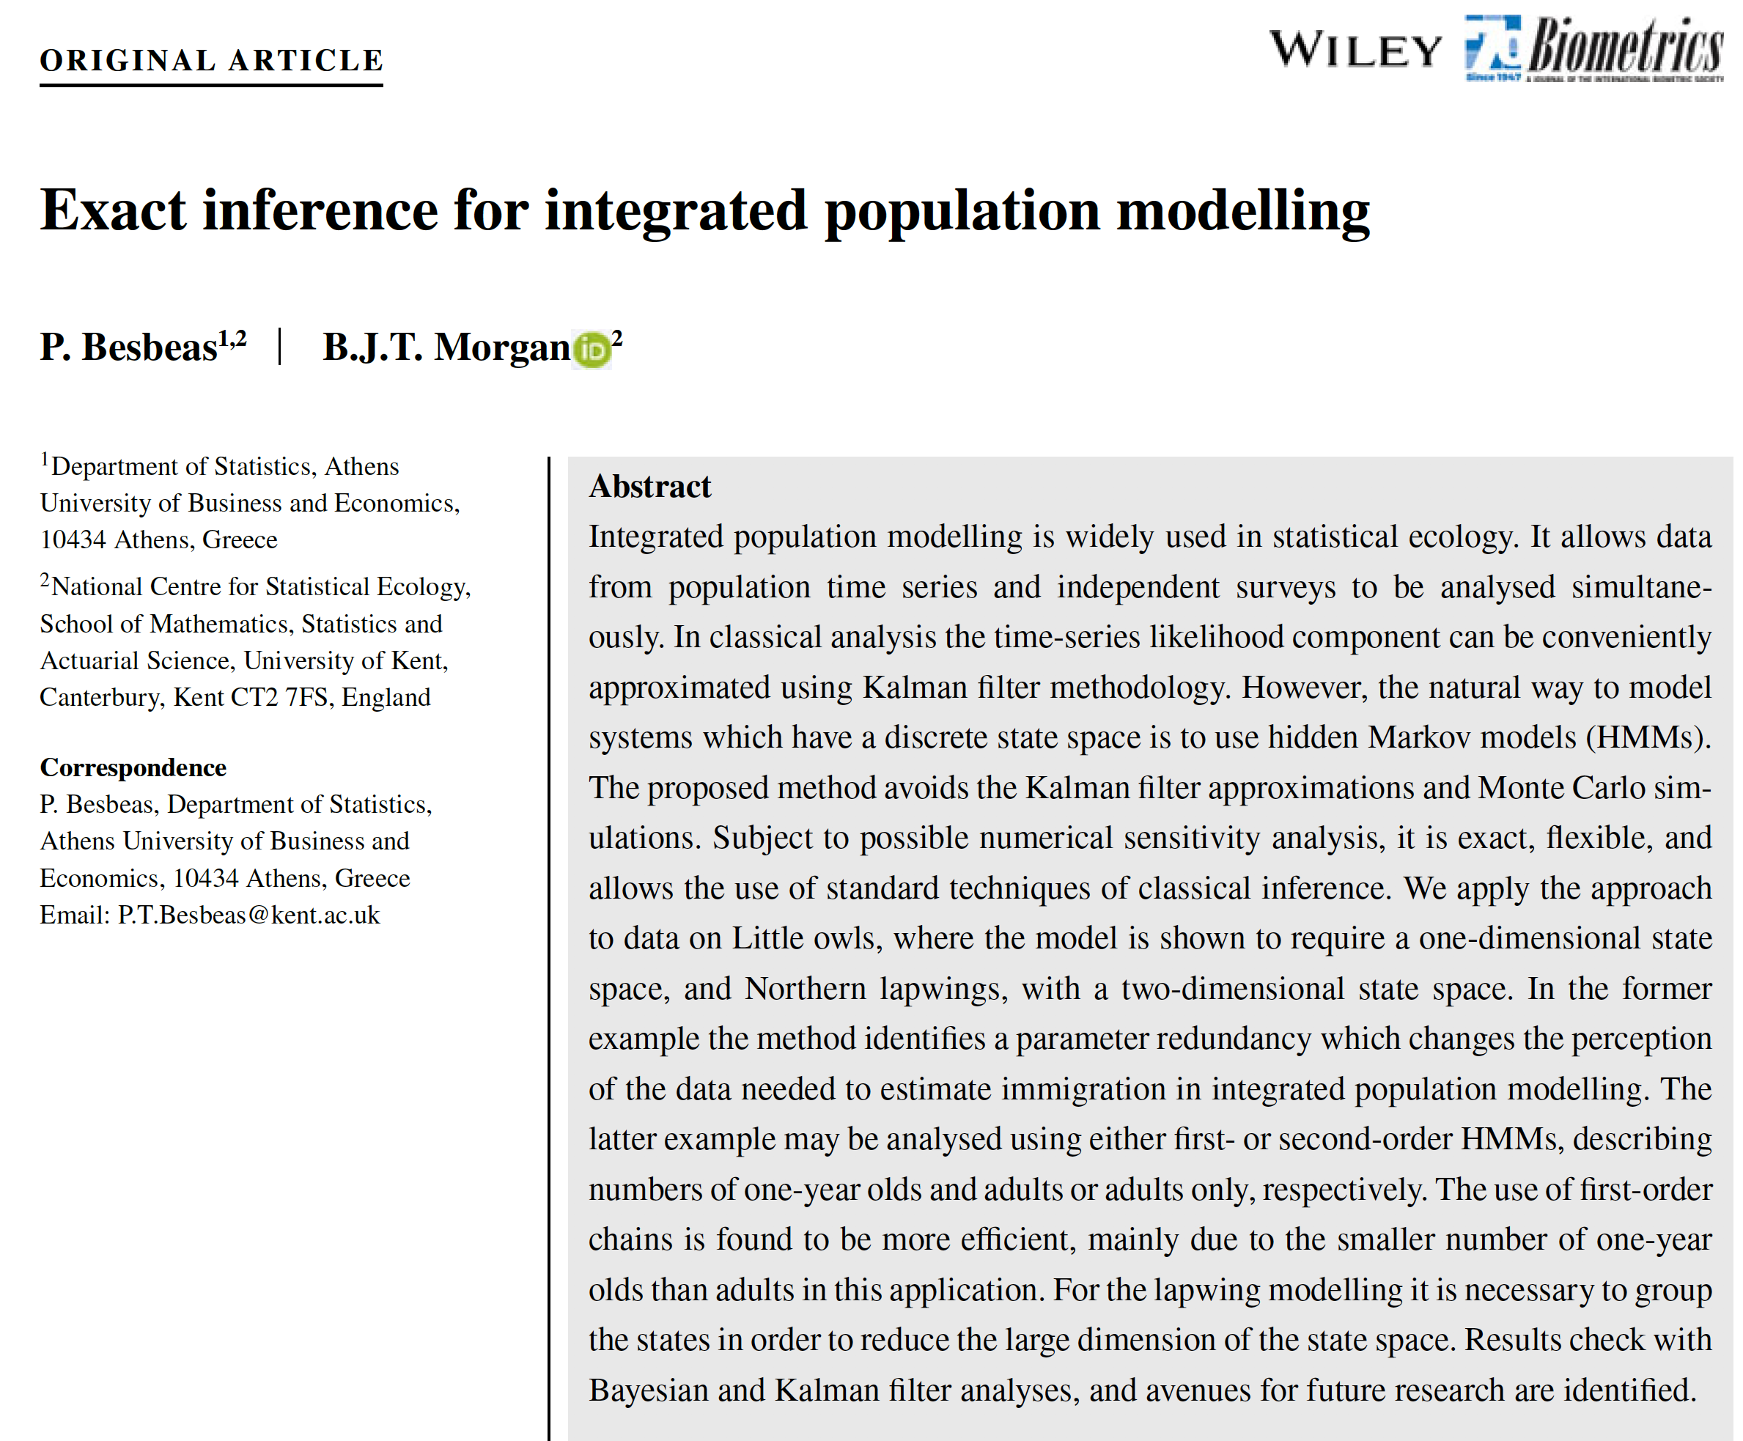
HMMs are a promising unifying modelling framework

Slide 82
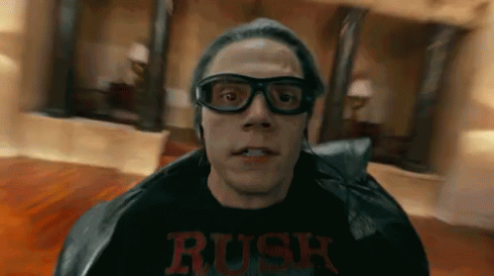
Fitting capture-recapture models in Jags may be slow -
A few tricks to speed up computations

Slide 83
Fitting capture-recapture models in Jags may be slow -
A few tricks to speed up computations
If your parameters are not individual specific, or time-independent, then avoid unecessary loops and memory usage.
Get rid of the latent states via marginalization (Yackulic et al. 2020).
Use a condensed formulation of the likelihood with sufficient statistics called m-arrays. See bonus slides.
MCMC algorithms picked by Jags might be unadapted. Switch to Nimble to take full control of MCMC machinery, e.g. Maud’s talk Friday.

Slide 84
Fitting capture-recapture models in Jags may be slow -
A few tricks to speed up computations
If your parameters are not individual specific, or time-independent, then avoid unecessary loops and memory usage.
Get rid of the latent states via marginalization (Yackulic et al. 2020).
Use a condensed formulation of the likelihood with sufficient statistics called m-arrays. See bonus slides.
MCMC algorithms picked by Jags might be unadapted. Switch to Nimble to take full control of MCMC machinery, e.g. Maud’s talk Friday.

Slide 85
Fitting capture-recapture models in Jags may be slow -
A few tricks to speed up computations
If your parameters are not individual specific, or time-independent, then avoid unecessary loops and memory usage.
Get rid of the latent states via marginalization (Yackulic et al. 2020).
Use a condensed formulation of the likelihood with sufficient statistics called m-arrays. See bonus slides and King & McCrea (2014).
MCMC algorithms picked by Jags might be unadapted. Switch to Nimble to take full control of MCMC machinery, e.g. Maud’s talk Friday.

Slide 86
Fitting capture-recapture models in Jags may be slow -
A few tricks to speed up computations
If your parameters are not individual specific, or time-independent, then avoid unecessary loops and memory usage.
Get rid of the latent states via marginalization (Yackulic et al. 2020).
Use a condensed formulation of the likelihood with sufficient statistics called m-arrays. See bonus slides and King & McCrea (2014).
MCMC algorithms picked by Jags might be unadapted. Switch to Nimble to take full control of MCMC machinery, e.g. Maud’s talk on Friday.

Slide 87
Exercise 4

Slide 88
Bonus

Slide 89
Multistate models are very flexible: some examples
1. Age-dependent survival
State-space likelihood
dead
adult
juvenile
States at time t+1
juvenile
adult
dead
State process
States at time t
Observations at time t
Not recapt.
Recapt. as ad
Recap. as juv
juvenile
adult
dead
Observation
process
States at time t
Notes:
89
Model is described in the appendix of BPA
If the data set includes only individuals that are marked as juv., then the observation states could consist only of „seen“ and „not seen“

Slide 90
Multinomial model for multistate capture-recapture data
As for single state capture-recapture, we can summarize multistate capture-recapture data in multistate m-array format
Data analysed using the multinomial likelihood

Slide 91
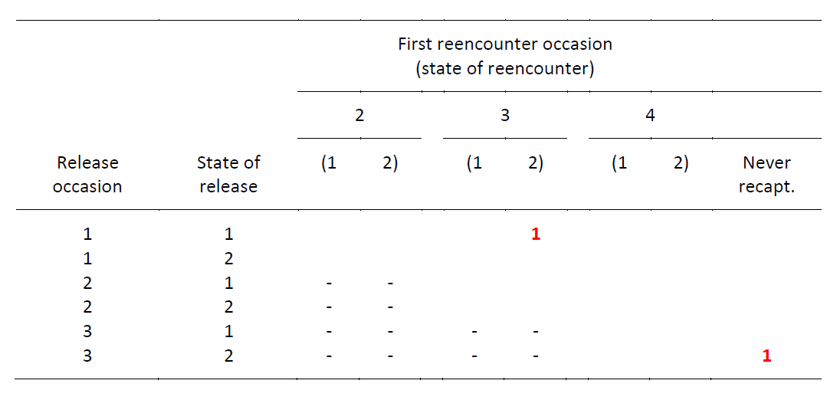
Multinomial model for multistate capture-recapture data
From the capture-histories to the m-array data format
Multistate capture histories
1 0 2 0
2 2 0 0
1 0 2 1
0 1 0 0
Multistate m-array

Slide 92
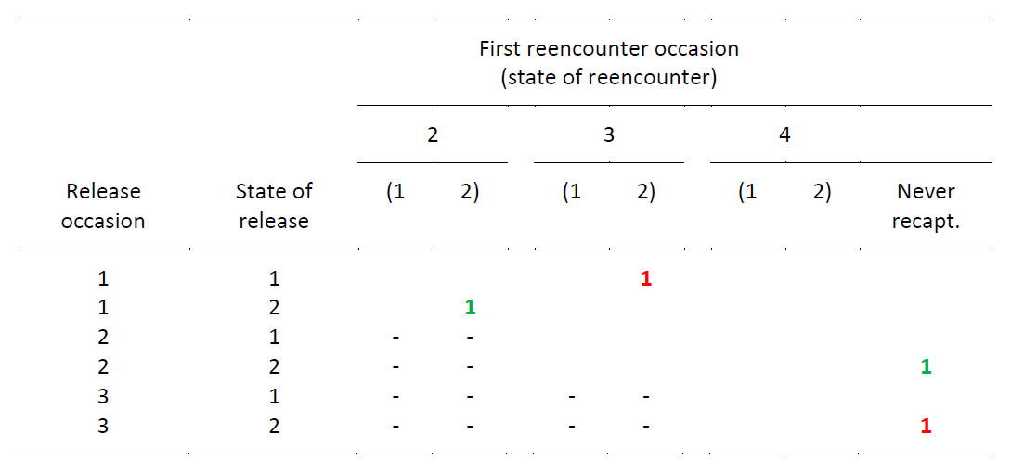
Multinomial model for multistate capture-recapture data
From the capture-histories to the m-array data format
Multistate capture histories
1 0 2 0
2 2 0 0
1 0 2 1
0 1 0 0
Multistate m-array

Slide 93
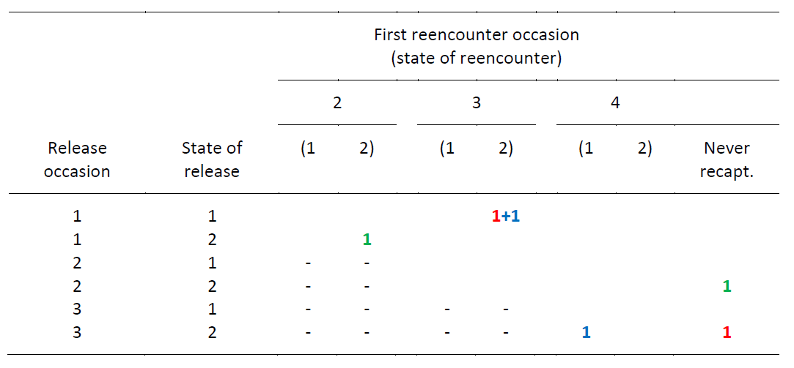
Multinomial model for multistate capture-recapture data
From the capture-histories to the m-array data format
Multistate capture histories
1 0 2 0
2 2 0 0
1 0 2 1
0 1 0 0
Multistate m-array

Slide 94
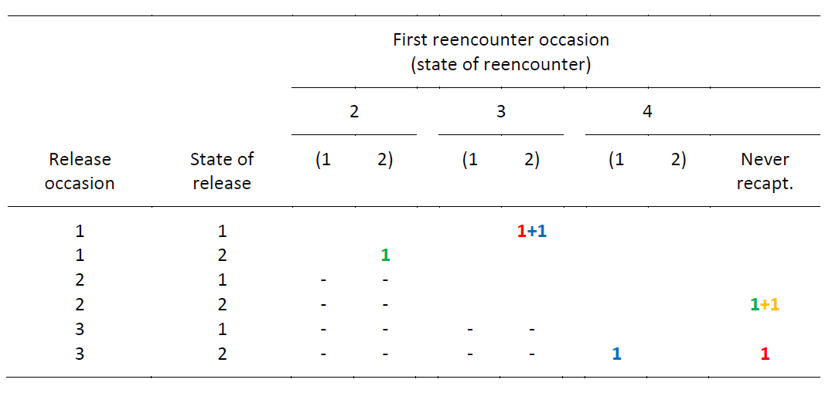
Multinomial model for multistate capture-recapture data
From the capture-histories to the m-array data format
Multistate capture histories
1 0 2 0
2 2 0 0
1 0 2 1
0 2 0 0
Multistate m-array

Slide 95
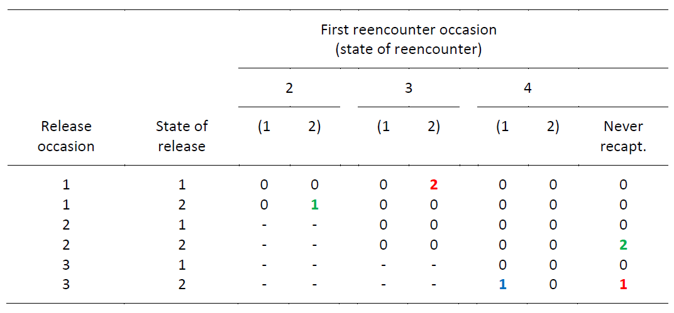
Multinomial model for multistate capture-recapture data
From the capture-histories to the m-array data format
Multistate capture histories
1 0 2 0
2 2 0 0
1 0 2 1
0 2 0 0
Multistate m-array

Slide 96
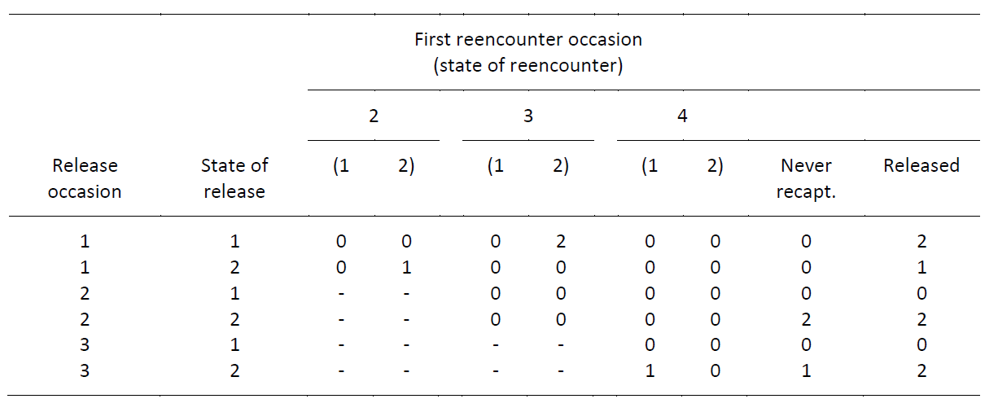
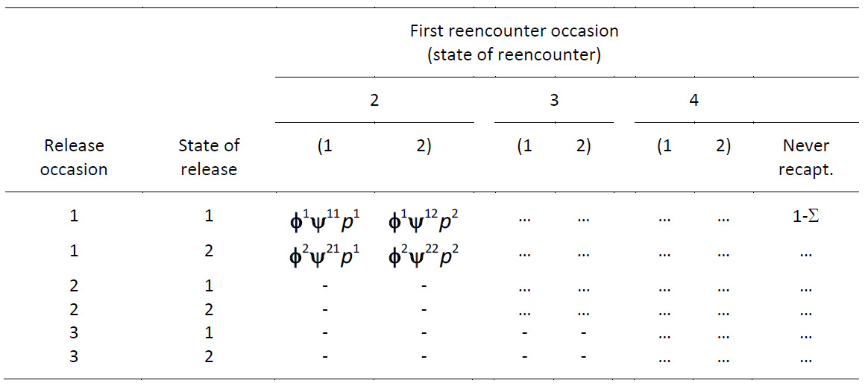

Slide 98
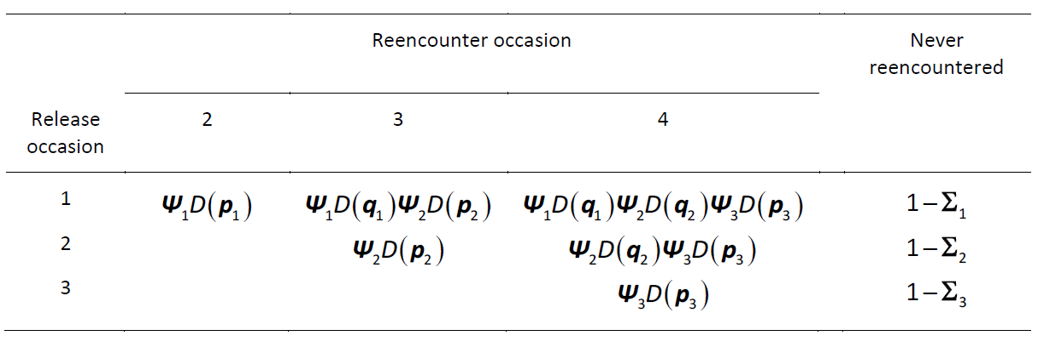
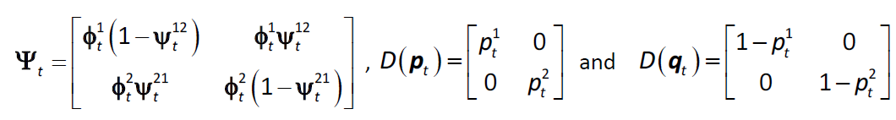
How to write the probabilities of the multistate m-array?

Slide 99
Comparison of approaches
State-space likelihood
Very intuitive, very flexible modelling
State transition matrix must include the death state
Observation matrix must include the observation not seen
Rows of transition and observation matrices must sum to 1
Computationally demanding
Multinomial likelihood
Reduced flexibility in modelling (no individual random effects)
The definition of transition matrix and of recapture vector very similar to the corresponding definitions in MARK or E-SURGE
Computational advantages (shorter run-time, faster convergence)

